Slide 1
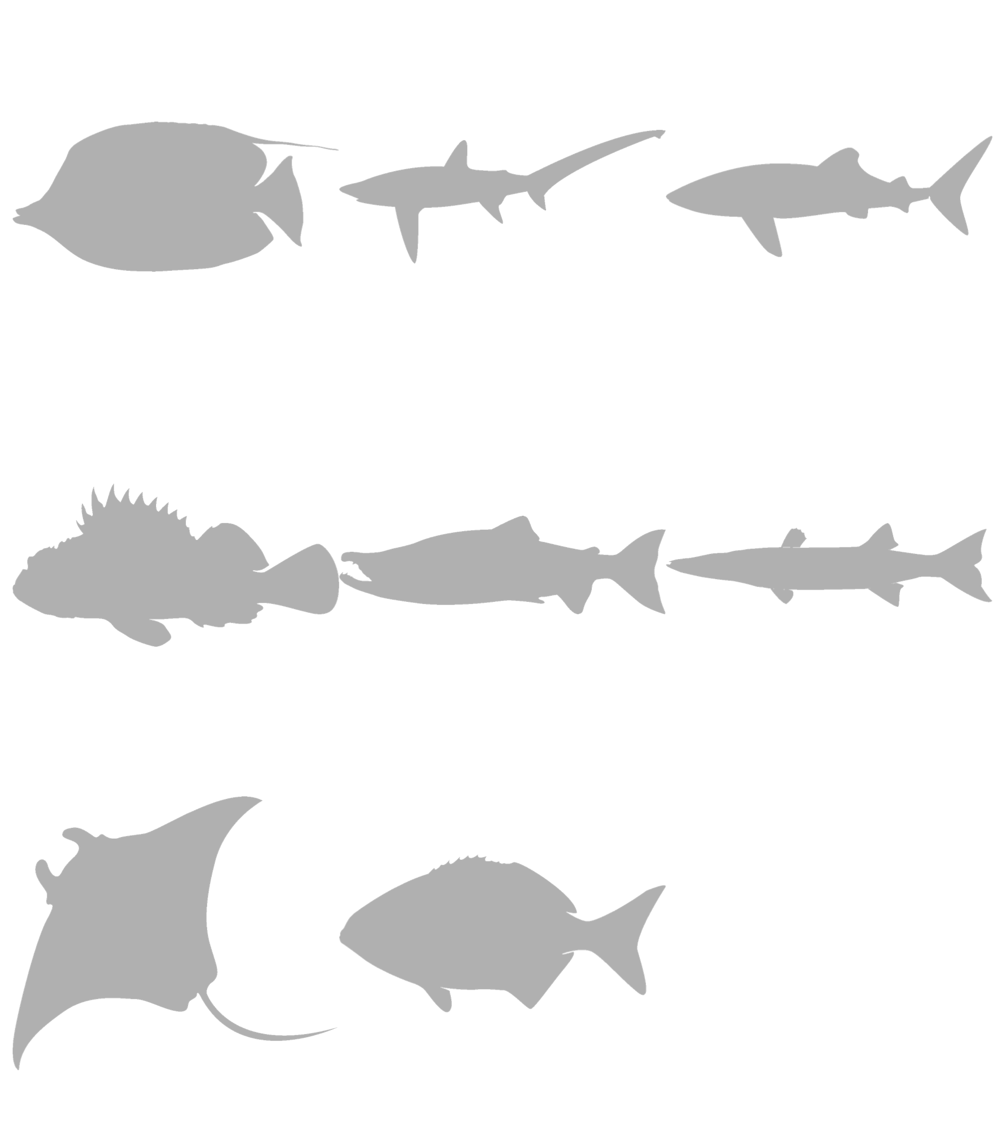
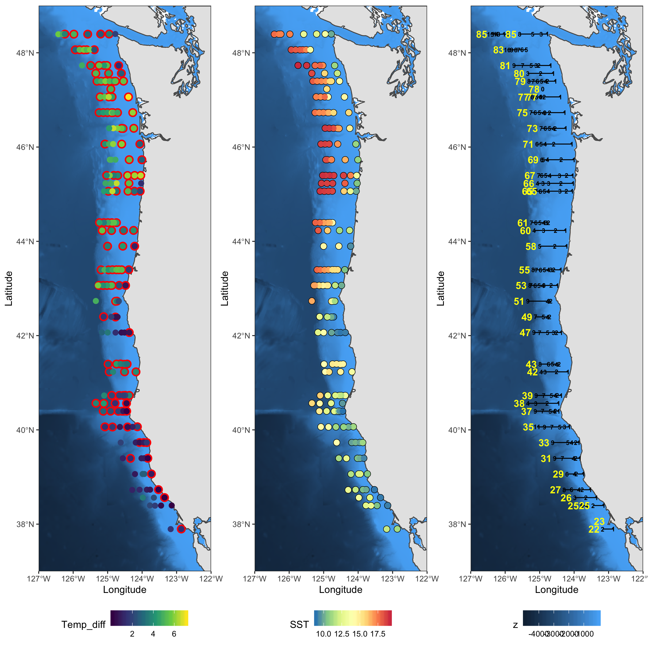

SPECIES DETECTION
STOCK ASSESMENT
ANADROMOUS
Fish Migration
MARINE COMMUNITIES
Developing methods
Simulation and Statistics
ENVIRONMENTAL Change
DIET ANALYSIS
HABs
Bioinformatics

Slide 2
MARINE COMMUNITIES
ENVIRONMENTAL Change
SPECIES DETECTION
Simulation and Statistics
Developing methods
Bioinformatics

Slide 3
MARINE COMMUNITIES
ENVIRONMENTAL Change

Slide 4
SPECIES DETECTION
STOCK ASSESMENT
ANADROMOUS
Fish Migration
MARINE COMMUNITIES
Simulation
And
Statistics
Developing methods
ENVIRONMENTAL Change
Bioinformatics
DIET ANALYSIS
HABs

Slide 5
SPECIES DETECTION
STOCK ASSESMENT
ANADROMOUS
Fish Migration
MARINE COMMUNITIES
Developing methods
Simulation and Statistics
ENVIRONMENTAL Change
DIET ANALYSIS
HABs
Bioinformatics

Slide 6
SPECIES DETECTION
STOCK ASSESMENT
ANADROMOUS
Fish Migration
MARINE COMMUNITIES
Developing methods
Simulation and Statistics
ENVIRONMENTAL Change
DIET ANALYSIS
HABs
Bioinformatics

Slide 7
SPECIES DETECTION
STOCK ASSESMENT
ANADROMOUS
Fish Migration
MARINE COMMUNITIES
Developing methods
Simulation and Statistics
ENVIRONMENTAL Change
DIET ANALYSIS
HABs
Bioinformatics

Slide 8
SPECIES DETECTION
STOCK ASSESMENT
ANADROMOUS
Fish Migration
MARINE COMMUNITIES
Simulation and Statistics
Developing methods
ENVIRONMENTAL Change
Bioinformatics
DIET ANALYSIS
HABs

Slide 9
SPECIES DETECTION
STOCK ASSESMENT
ANADROMOUS
Fish Migration
MARINE COMMUNITIES
Simulation and Statistics
Developing methods
ENVIRONMENTAL Change
DIET ANALYSIS
HABs
Bioinformatics

Slide 12
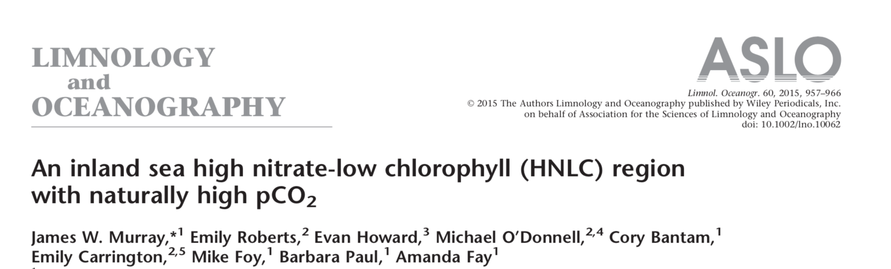
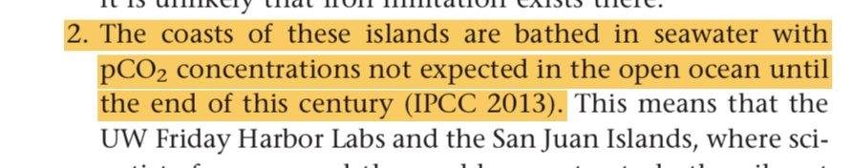

Slide 13
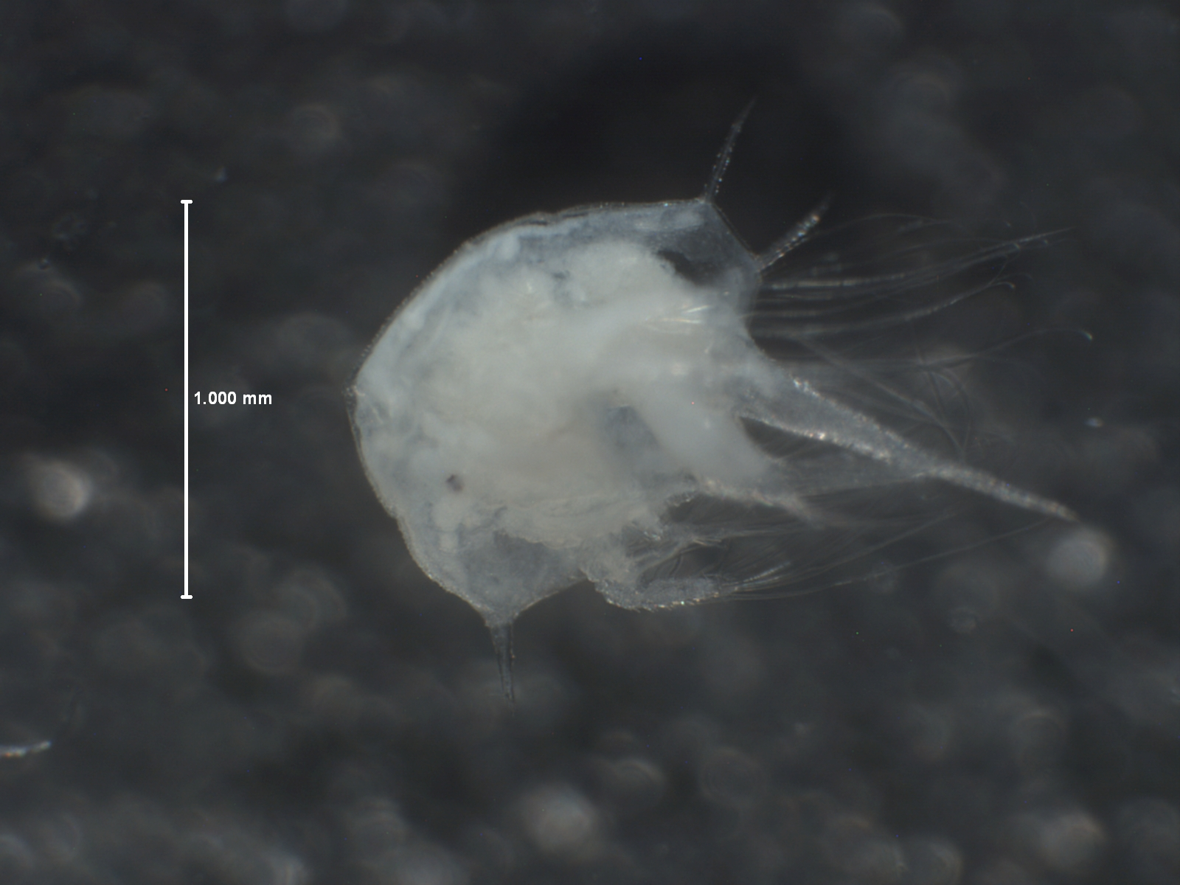

Slide 14
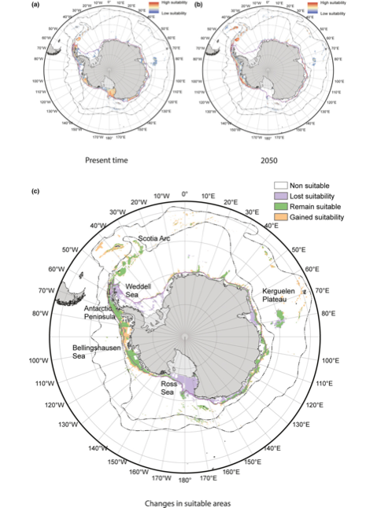
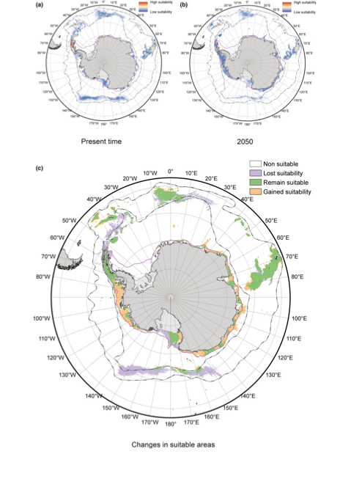

Slide 15
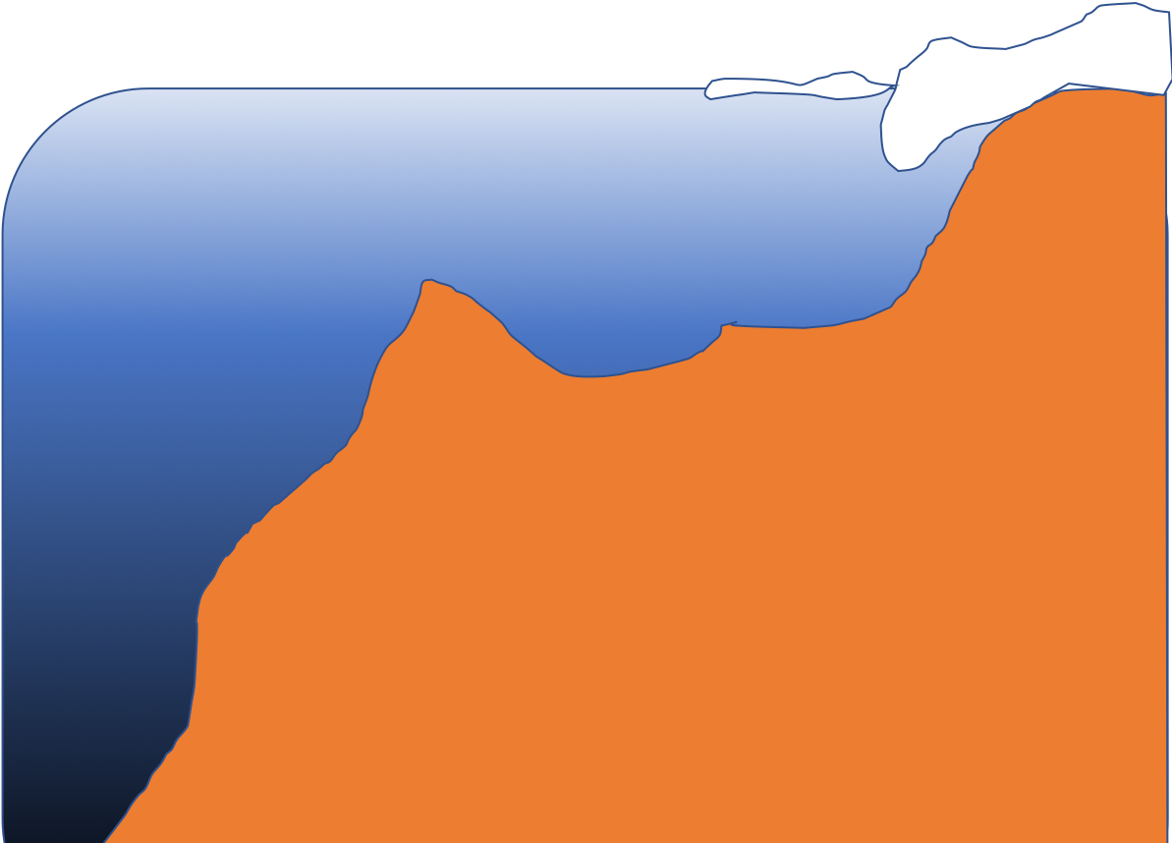

Slide 16


Slide 17
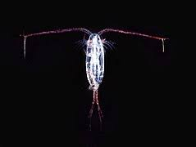
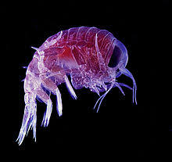
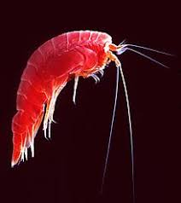

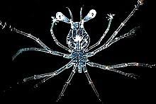
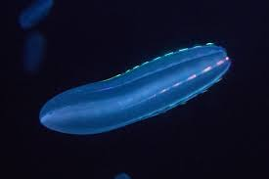
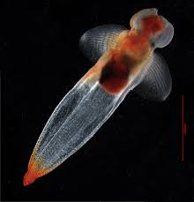
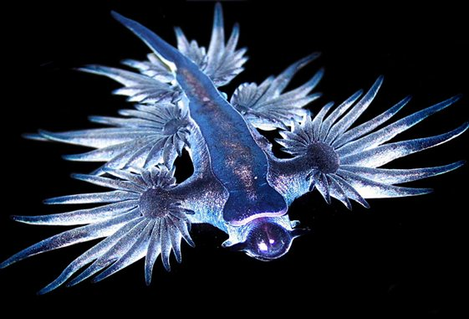
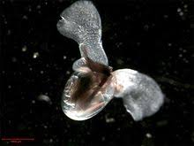

Slide 18



